Slide 1
Congressional Papers Roundtable pre-conference, Society of American Archivists
Capitol Visitors Center, Washington, DC
August 13, 2014
Andrea L’Hommedieu, creator & presenter
South Caroliniana Library
University of South Carolina
803.777.3133
alhomme@mailbox.sc.edu

Slide 2
Oral History as part of the political archival landscape
How to successfully create an oral history collection that both augments and complements an institution’s congressional collections

Slide 3
OVERVIEW
Creating a solid foundation: Policies, Outline and Budget
Who and What to Ask: How and Why
The Continuum: Keeping all parts of the project moving
Legal and Ethical considerations: Release forms and Restricted interviews
Expecting the Unexpected: planning for pitfalls

Slide 4
Methodology
When conducting oral history interviews, it is important to remember that the information we are seeking is best obtained by helping the interviewees to tell their stories. Oral histories should not be dry recitations of facts, but engaging remembrances of the interviewee’s experiences and insights. Recollections are frequently at odds with contemporaneous documents. The recollections are better treated as clues than absolute facts.

Slide 5
FoundATIONAL WORK
Create a document that spells out the guidelines, policies and goals of the project in enough detail to ensure consistency from all involved. Manual and one-page project description.
Develop letters to communicate with interviewees through the stages of the interview process: invitation, thank you, transcript review.
Build an outline of the politician’s life and career, which will become the list of subject areas to research and people to interview. Include childhood years, educational experiences, military service, and other areas pre- and post-congressional career.
Manual for the George J. Mitchell Oral History project: http://library.bowdoin.edu/arch/george-j-mitchell/oral-history/OralHistoryManual%20Mitchell%202011May.pdf

Slide 6
Who are the interviewees
Prioritize who to interview & creating a list
Cover all areas of the subject’s life
Age and health of potential interviewees
Be sure to represent women and minorities
The circumspect factor: platitudes vs. genuine insights
Strength of connection to the subject
Make your list 1.5 times larger than your goal

Slide 7
What to Ask: How and why
Begin forming questions you’ll want to ask, on particular subjects, with many interviewees.
Have a list of general questions to ask everyone to set them in context-- for the interview to stand by itself
Have specific sets of questions depending on their relationship to the focus of the project.
For a list of examples of how to ask questions, follow this link:
http://library.sc.edu/socar/oralhist/Effective%20Question%20Formats.pdf

Slide 8
Budget considerations
Interviews: decide how many---this will drive other costs of the project.
Equipment: Ability to record in WAV; Use External Mics
Oral History in the Digital Age web site: http://ohda.matrix.msu.edu/doug/
Digital Audio Field Recording Equipment Guide, Vermont Folklife Center: http://www.vermontfolklifecenter.org/archive/res_audioequip.htm
Interviewers: in-house staff vs. subcontracting
Student assistants
Transcription and editing
Budget $100-$125 in transcription costs per hour of recording (based on good sound quality}
Database and web development

Slide 9
The George J. Mitchell Oral history project
Three-year project
225 interviews
$600 average cost per interview
All interviews transcribed, edited and indexed
Over 90% available online as transcripts and sound recordings
2012 recipient of OHA’s Elizabeth B. Mason Major Project Award
Web site: http://digitalcommons.bowdoin.edu/mitchelloralhistory/

Slide 10
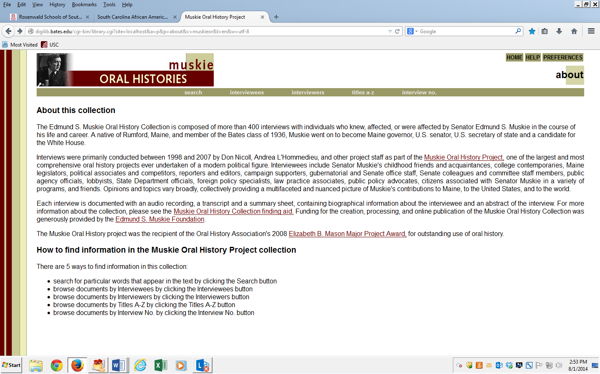
Edmund S. Muskie Collection
440 interviews
9.5 years
Appropriation from Congress

Slide 11
The Continuum
A project successfully completed within a specified time frame requires the ability to juggle the many elements continuously.
To use a 3-year project as an example, and a goal of 100 interviews, here’s an idea of what the timeline would look like:

Slide 12
Year 1
Write the document that will guide your project
Research topic/s and develop questions
Identify interviewees, prioritize, and create the list.
Contract with Interviewers and Transcribers
Begin interviewing by the 5th month (that means have ‘invitation’ letters in the mail by the 3rd-4th month)

Slide 13
Year 2
Emphasis on getting all interviews scheduled and completed.
Transcription work should be at a consistent pace with interviewing.
Create a database or worksheet to track the status of interviews.
Start planning design and content of an online presence, including what metadata you’ll need.

Slide 14
Year 3
Wrap up all interviewing in first three months. Should be only those who were ill or busy when first contacted.
Emphasis on transcription, editing and transcript review.
Make sure release forms are signed.
Regardless of funding source, write a detailed description of the project’s results. For ongoing programs, an annual report.

Slide 15
Legal and Ethical considerations
Release forms
Example here: http://library.sc.edu/socar/oralhist/RELEASE%20FORM%20master.pdf
Restricted interviews (and the Boston College case)
Oral History Association: www.oralhistory.org
“Principles and Best Practices”

Slide 16
Expecting the unexpected
Avoiding the Pitfalls
When interviewing is off-schedule with the project’s timeline
Slow interviewers
Hard to schedule interviewees
When transcribing doesn’t keep pace
Long distance interviewing: require landline access

